Slide 1



Crop yield prediction
G H Raisoni College of engineering and Management ,Pune.
* Student names:
1)Utkarsh Kalinkar
2)Deepa Yadav

Slide 2
Problem Statement
Brief Overview:
This case study addresses the challenge of predicting crop yield based on various factors such as temperature, rainfall, and pesticide use. Agriculture is a vital sector in India, and predicting crop yield accurately helps farmers and policymakers make informed decisions to increase productivity and food security.
Key Objectives: - To analyze agricultural data and identify key factors affecting crop yield.
- To apply machine learning algorithms for predicting crop yield.
- To compare model performance and suggest the best-fit model.
- To support sustainable agricultural practices using data-driven insights
Source :
www.freepik.com/

Slide 3
Dataset Overview
Dataset Description:
- Source: Kaggle - Crop Production Dataset
- Size: Approximately 2,500+ records from Indian states over multiple years
- Attributes:
State Name – e.g., Maharashtra, Punjab
District Name
Crop – e.g., Rice, Wheat, Cotton
Season – Kharif, Rabi, Summer, etc.
Area (Hectares)
Production (Tonnes)
Year
- Key Features:
Historical crop yield data helps in pattern analysis.
Useful for training regression models to predict crop productivity.
Data can be combined with external weather/rainfall data to improve predictions.
Source :
www.freepik.com/

Slide 4
Methodology
Approach:
1. Data preprocessing: cleaning, handling missing values, encoding categorical variables.
2. Exploratory Data Analysis (EDA): identifying trends, correlations.
3. Model building: training multiple regression models.
4. Evaluation: using metrics like R² score and Mean Squared Error.
5. Model comparison: selecting the best performing algorithm.
Algorithms Used: - Linear Regression: baseline model.
- Random Forest Regressor: better accuracy and handles non-linearity.
- Support Vector Regression (optional): tested for performance.
- Decision Tree Regressor: interpretable model for decision making
Source :
www.freepik.com/

Slide 5
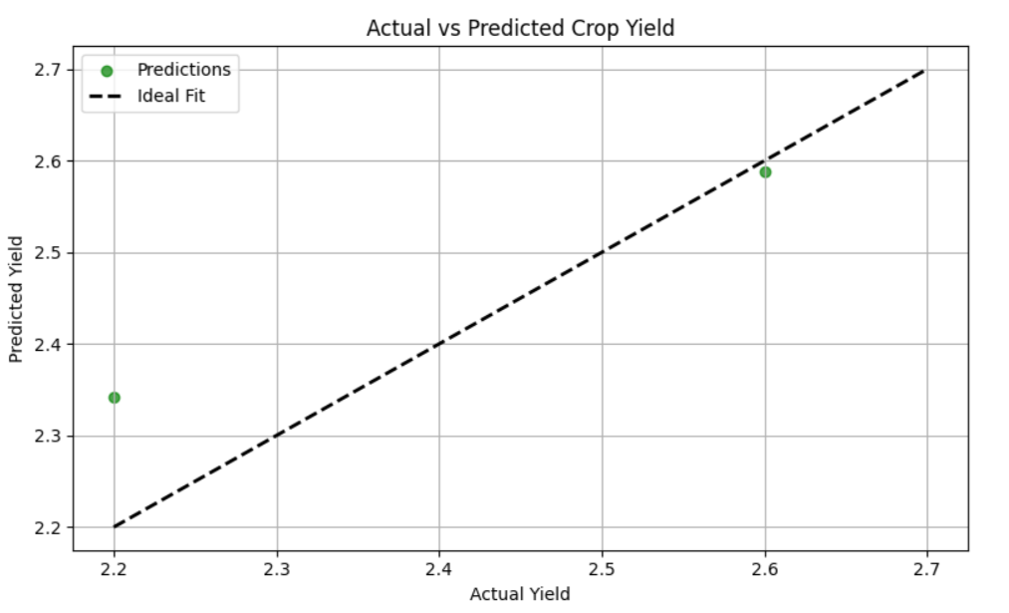
Output Graph

Slide 6

Conclusion
Summary:
The project successfully demonstrates that machine learning models, especially Random Forest, can predict crop yield with reasonable accuracy. The study highlights the importance of data quality, feature engineering, and model evaluation. Insights gained can assist agricultural stakeholders.
Future Work: - Use satellite data and real-time weather inputs for better accuracy.
- Deploy the model via a web/mobile interface for farmer access.
- Incorporate soil health and pricing data for comprehensive insights.
- Crop Specific Models :Train separate models for major crops like rice, wheat, or maize for better specialization.
Source :
www.freepik.com/

Slide 7
References
https://archive.ics.uci.edu/
https://www.kaggle.com/search?q=crop+yield+prediction
https://github.com/UtkarshK22/Crop-Yield-Prediction.git

Slide 8
Thank You
Notes:
Thank You !!

